Slide 1
Final Presentation
Hotel reservation system
我们毕业啦
其实是答辩的标题地方
Null
Team
Haonan Quan,
Yupeng Zhang,
Qimeng Jin

Slide 2
Problem statement
Approach
User
CONTANTS
Work Flow
UML

Slide 3

Problem Statement
It was the best of times, it was the worst of times; it was the age of wisdom, it was the age of foolishness.

Slide 4
Statment
Approach
Users
Work Flow
UML
“
As increasingly the higher level of spirit enjoyment, the tourism industry has been brought a sustained growth. It plays a key role in many countries, and it has a positive influence on national economy.
The tourism agency system become an important factor affecting the development of the tourist industry, which has interaction between multiply industrial field. So our group project aim to build an integration hotel booking network between online travel agency website, hotel, transportation company and users(both users from website also drivers from transportation company)
”

Slide 5
Statment
Approach
Users
Work Flow
UML
1
The customer usually book hotel through travel agency website instant of directly from hotel websites. The hotel always has business cooperation with travel agency website.
2
The airport pick-up and drop-off service is one of the important services provide by the hotel after the order placed.
3
The transport company have business corporation with hotel, the hotel will pick up suitable transport company for the customer.

Slide 6
Approach
It was the best of times, it was the worst of times; it was the age of wisdom, it was the age of foolishness.

Slide 7
Statment
Approach
Users
Work Flow
UML
Platform
Customer, travel agency website and hotel have a same login platform from the same system, which ensure the information can be synchronous update.
Business Flow
Customer can get information from the travel website, which can search by the city.
Hotel will double check the availability and return whether take it to the travel website, where the customer can check the status.
The hotel will pick the suitable transport company, send them request and information to match the drivers. The driver can choose take or not take the task.
Customer can review the order and the result will be show under the hotel’s details.
Order Completed

Slide 8
Users
It was the best of times, it was the worst of times; it was the age of wisdom, it was the age of foolishness.

Slide 9
USE
Registration & Log-in
View/Modify personal information
Change password
Search hotel and View details
Place order
Check order status
Check order history
Rating
Log-in
View/Modify personal information
Change password
Check review
Manage room information
Check, Confirm and View order
Manage Pickup and Drop-off service
Customer
Hotel
Travel
Website
Log-in
View/Modify personal information
Change password
Manage customer
Manage network and enterprise information
Transport
Company
Log-in
View/Modify personal information
Update company information
Manage the order and driver
Assign the task

Slide 10
Work Flow
It was the best of times, it was the worst of times; it was the age of wisdom, it was the age of foolishness.

Slide 11
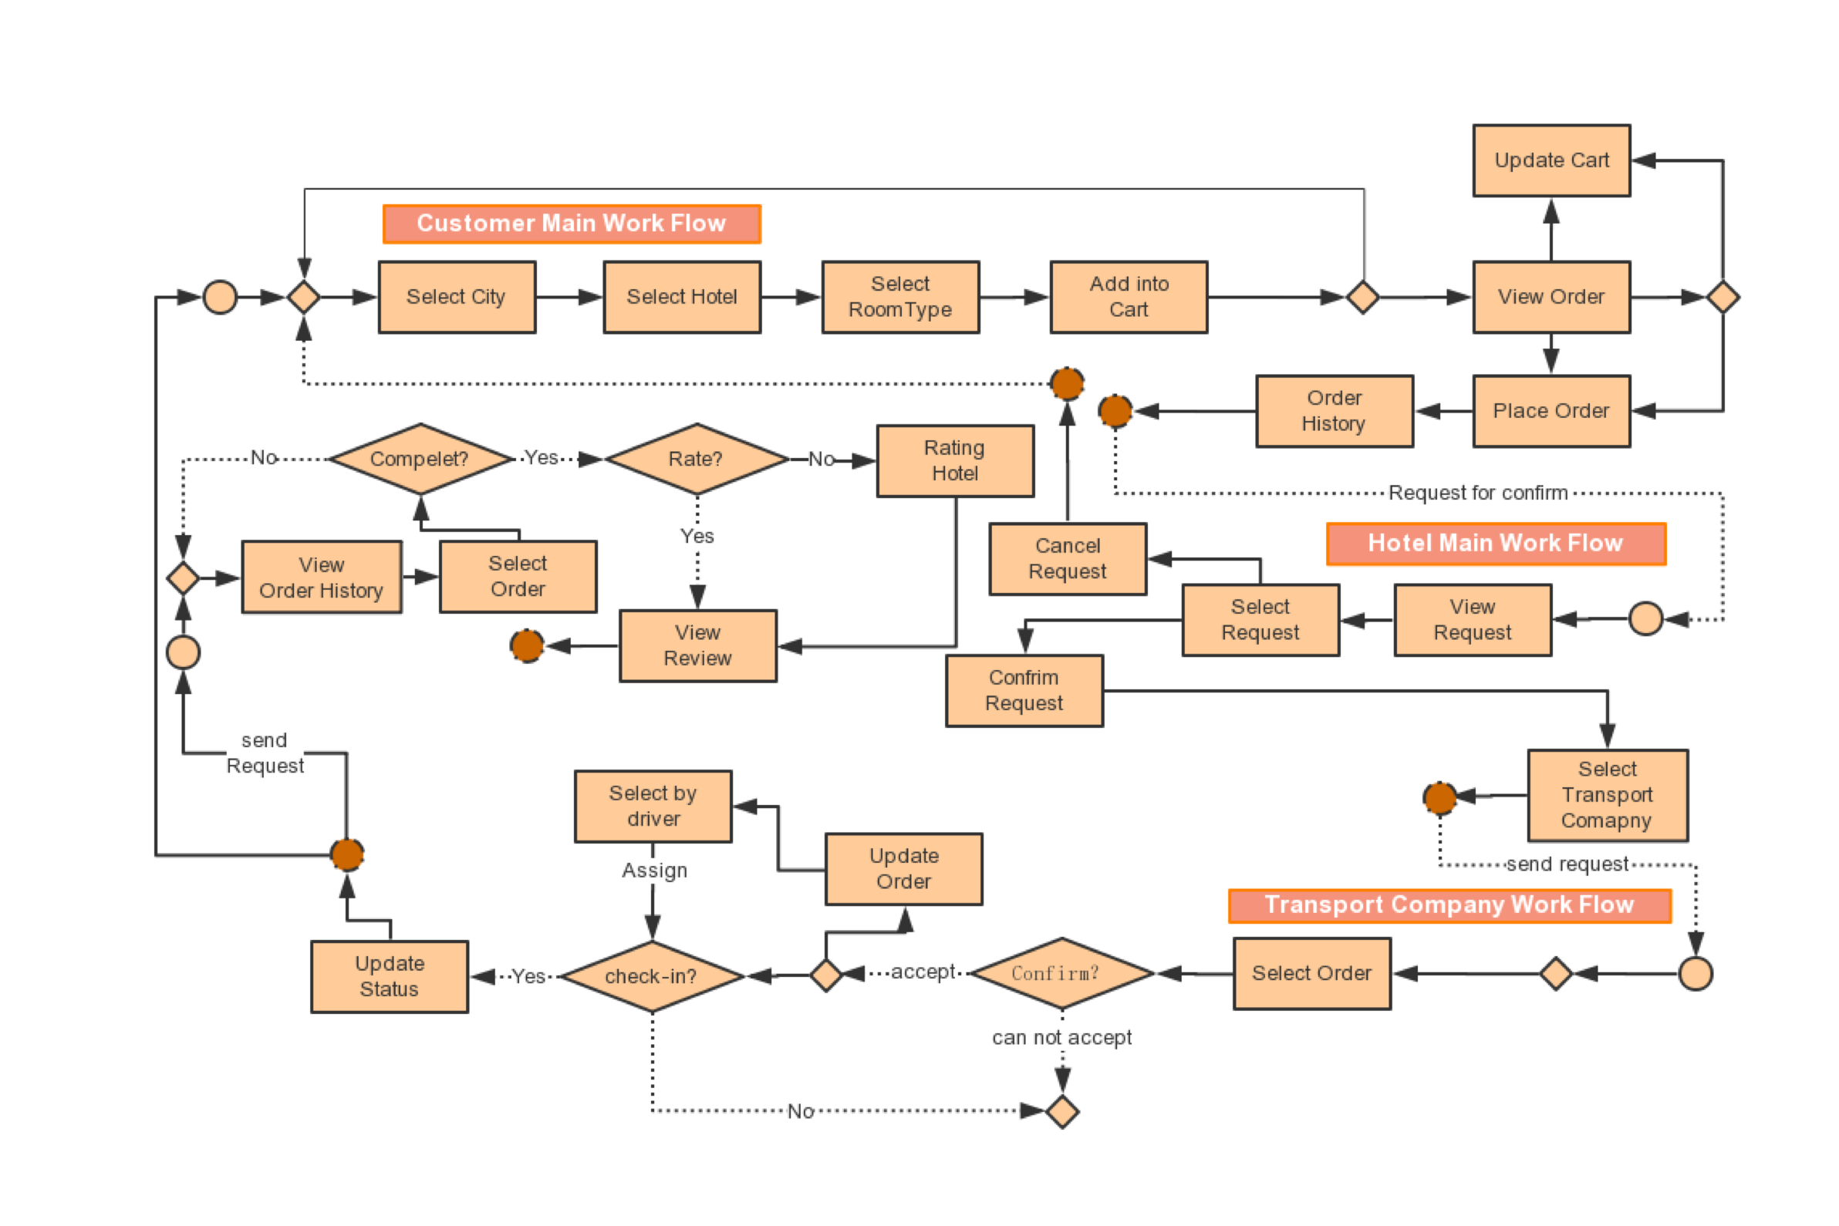

Slide 12
UML
It was the best of times, it was the worst of times; it was the age of wisdom, it was the age of foolishness.

Slide 13
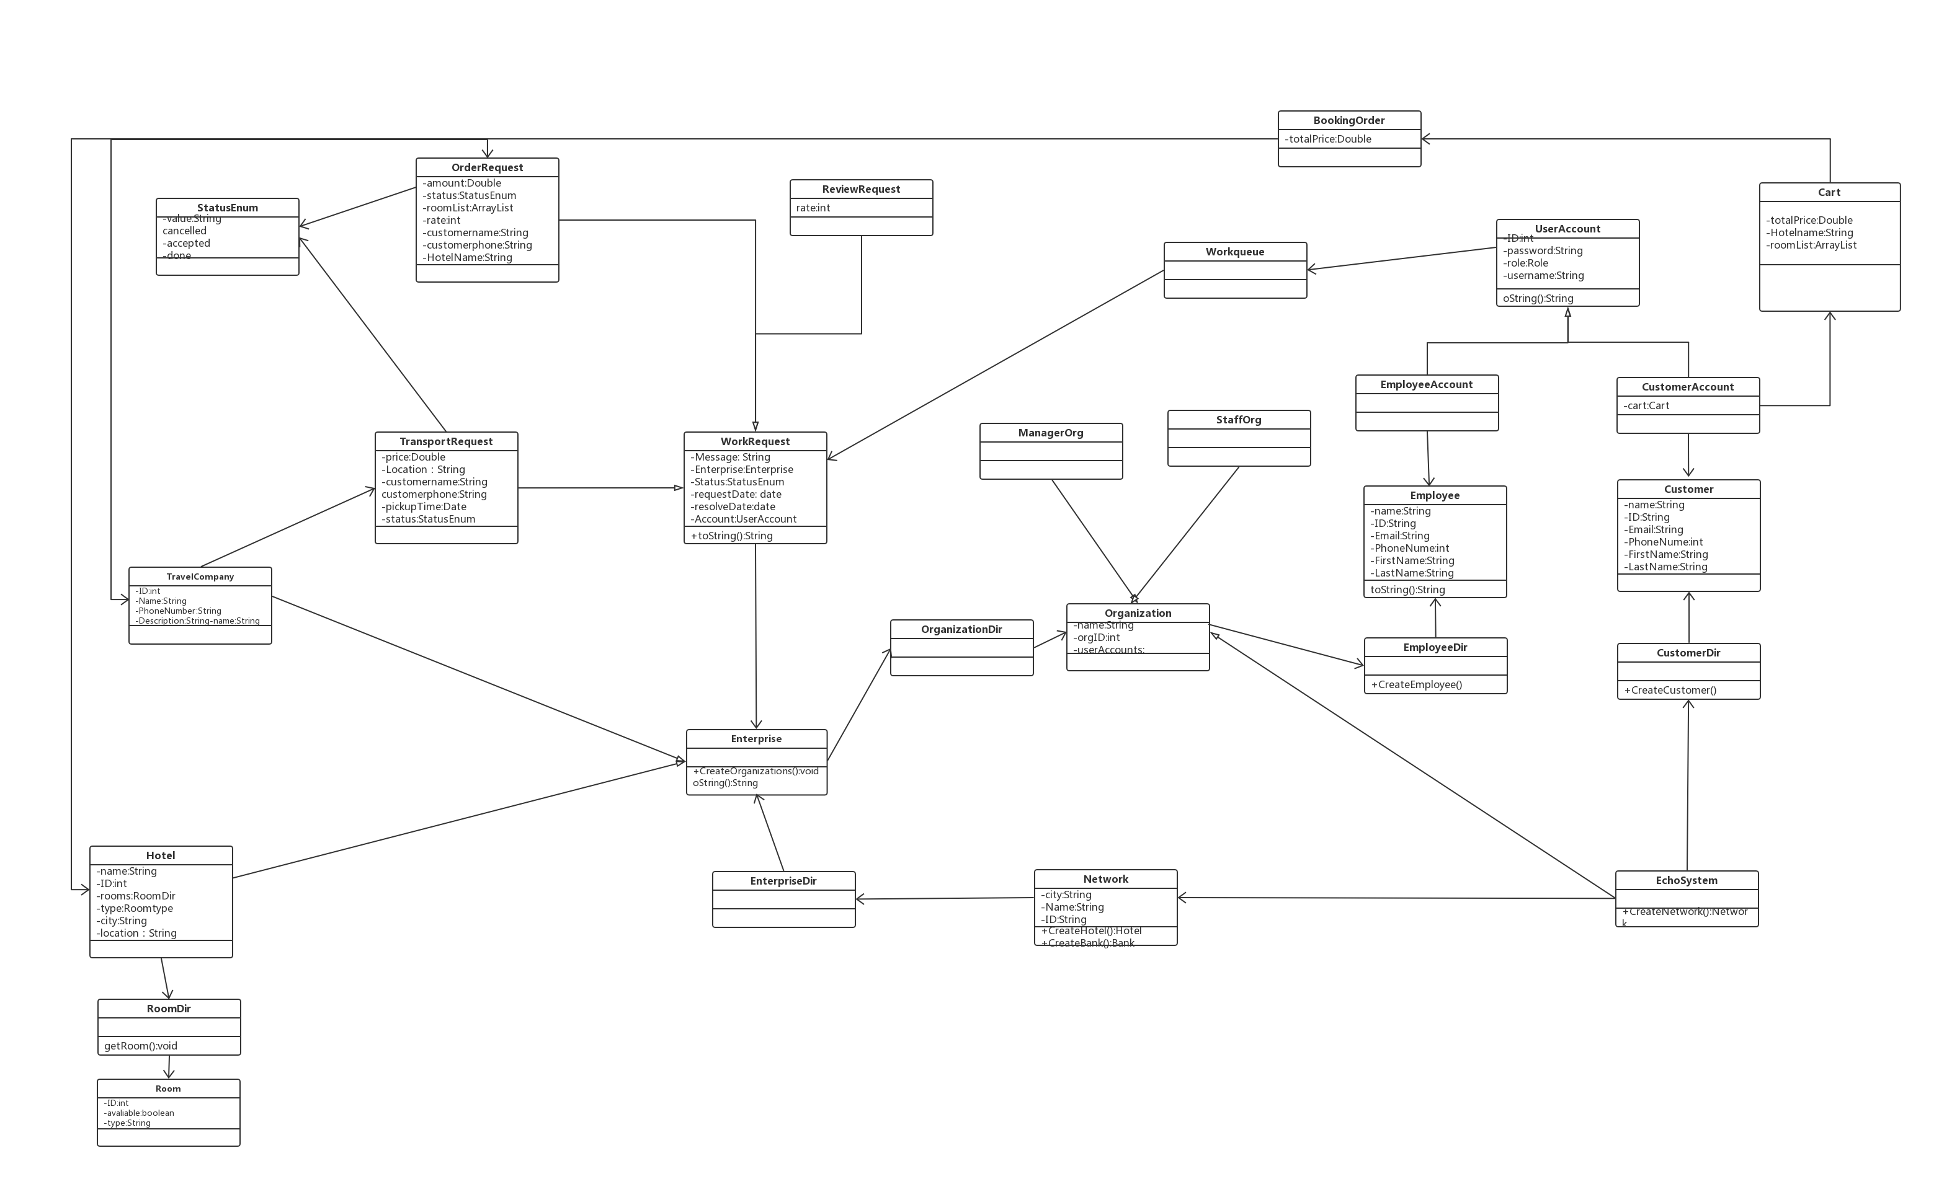

Slide 14
DEMO
It was the best of times, it was the worst of times; it was the age of wisdom, it was the age of foolishness.

Slide 15
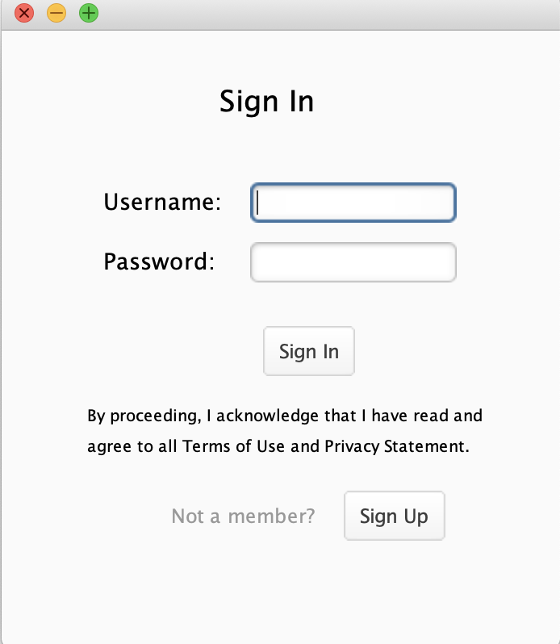
Sign In
For all users

Slide 16
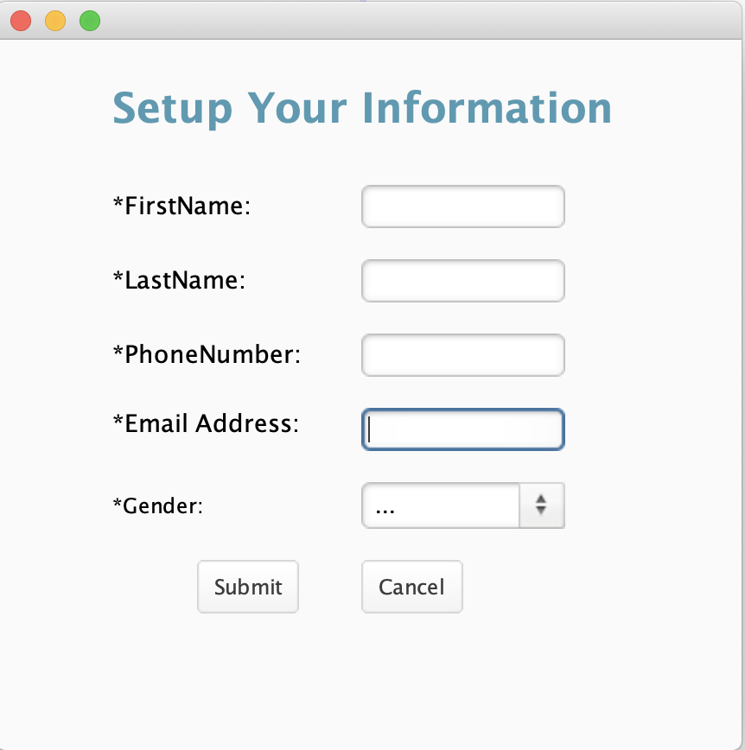
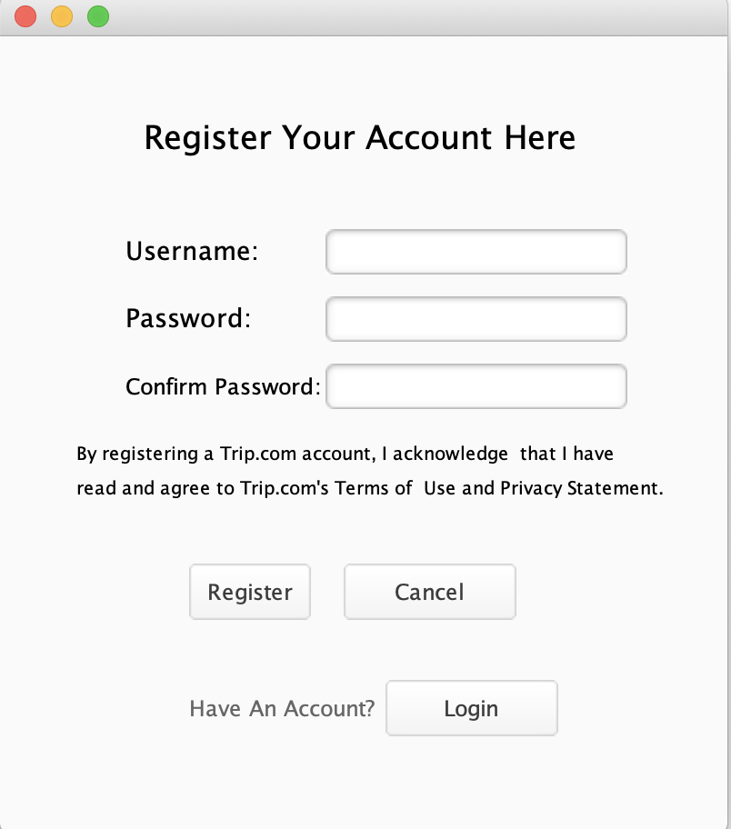
Register
For Customer

Slide 17
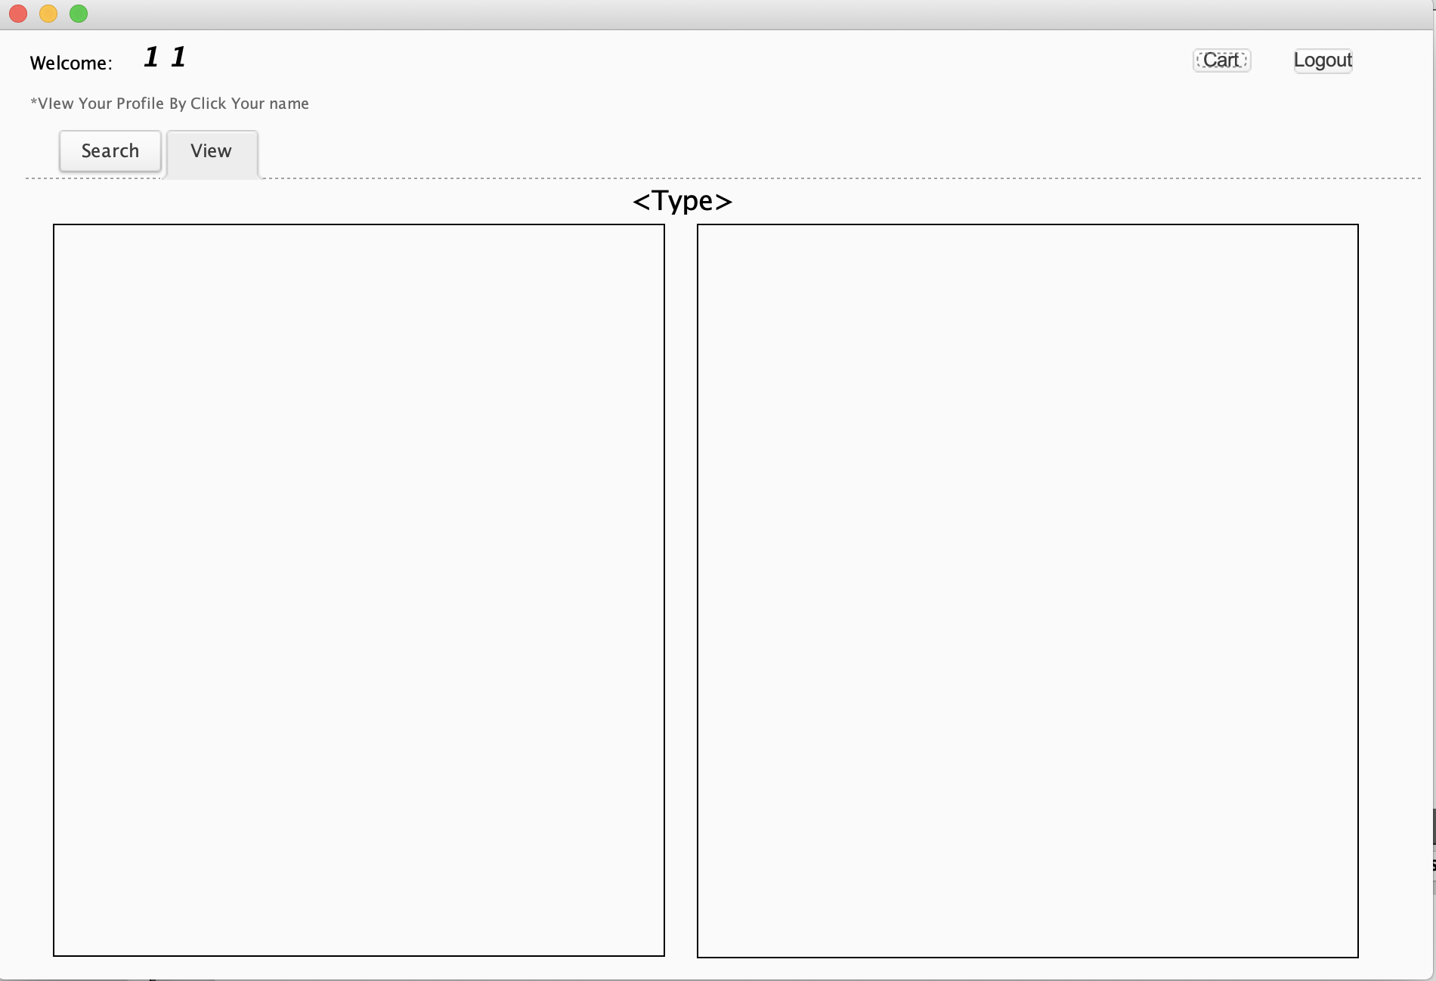
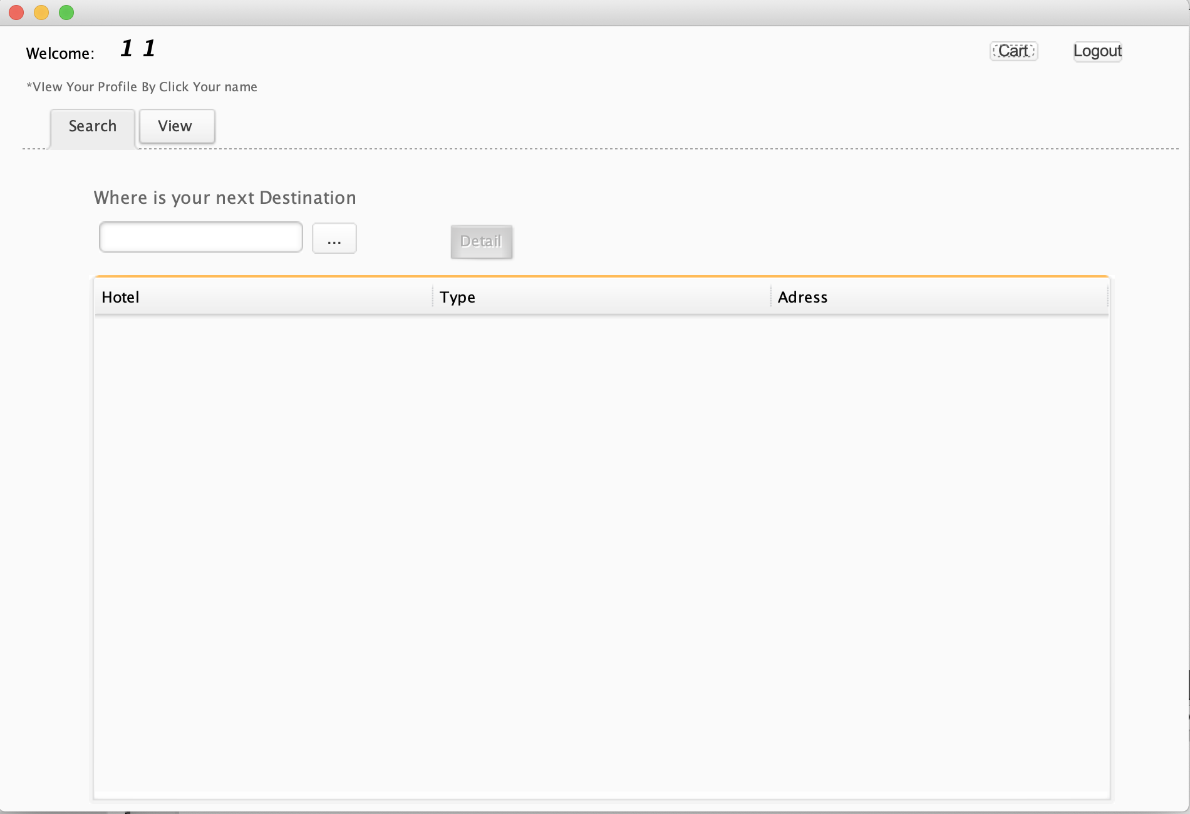
Main Page
For Customer

Slide 18
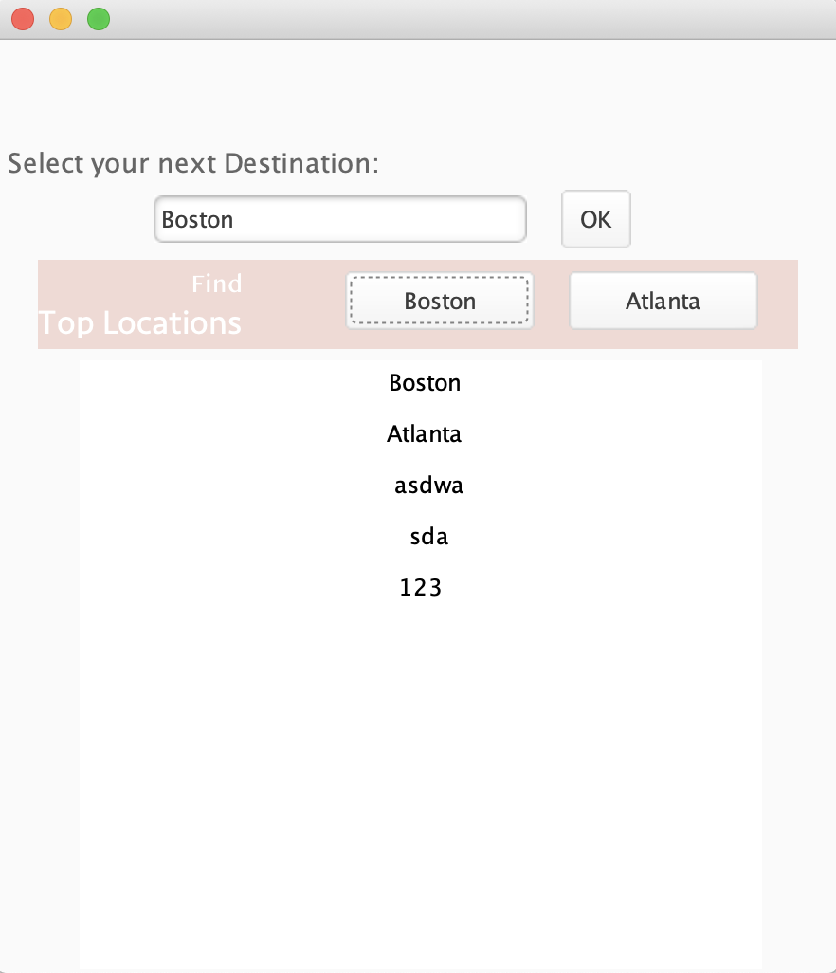
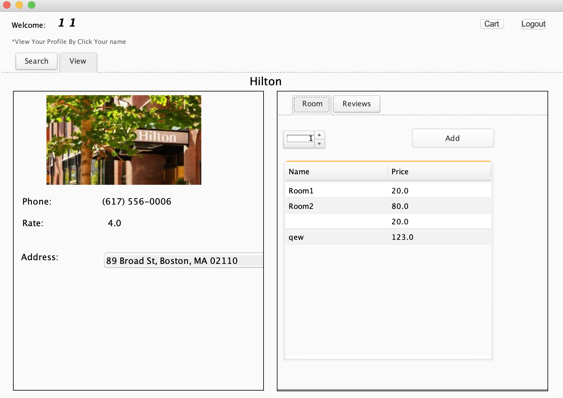
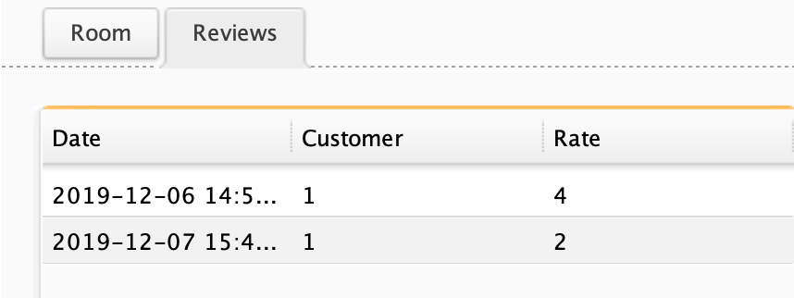
Hotel List&Details
For Customer

Slide 19
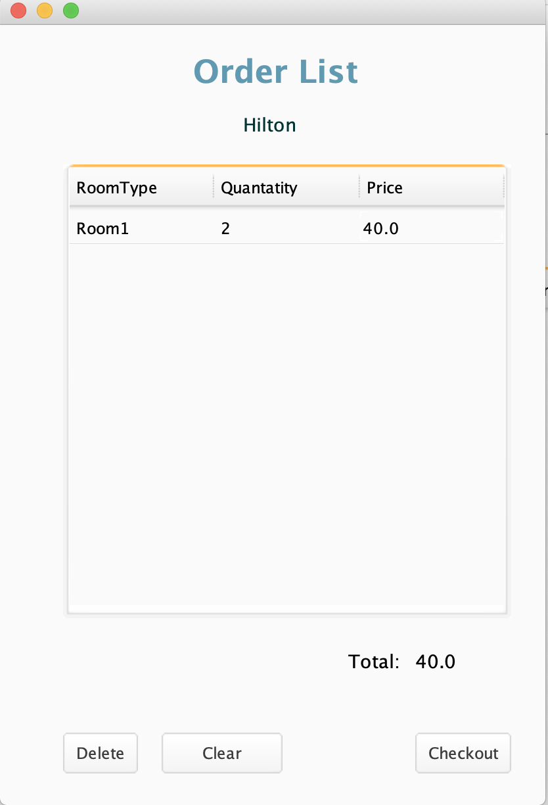
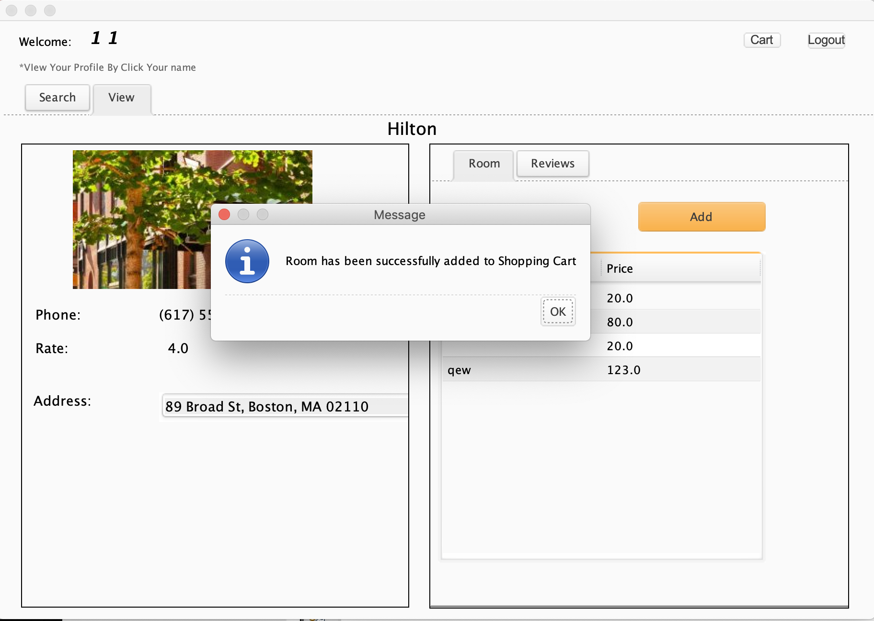
Add to Cart
For Customer

Slide 20
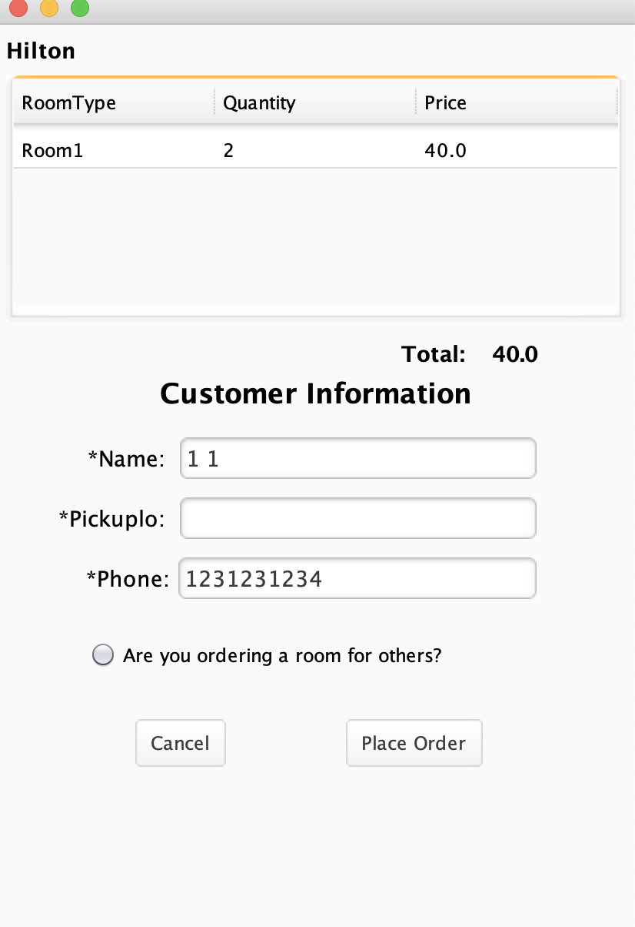
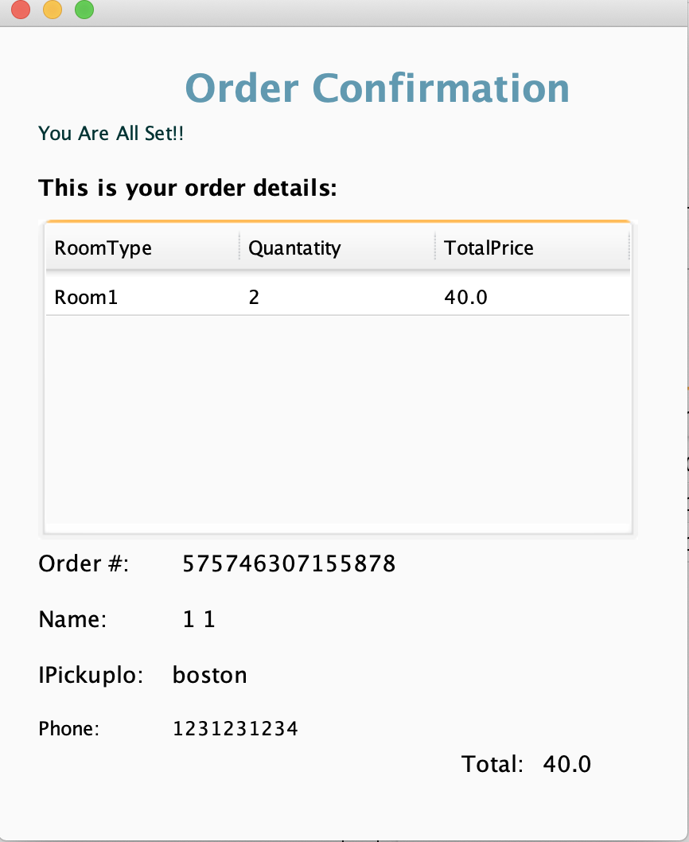
Place Order
For Customer

Slide 21
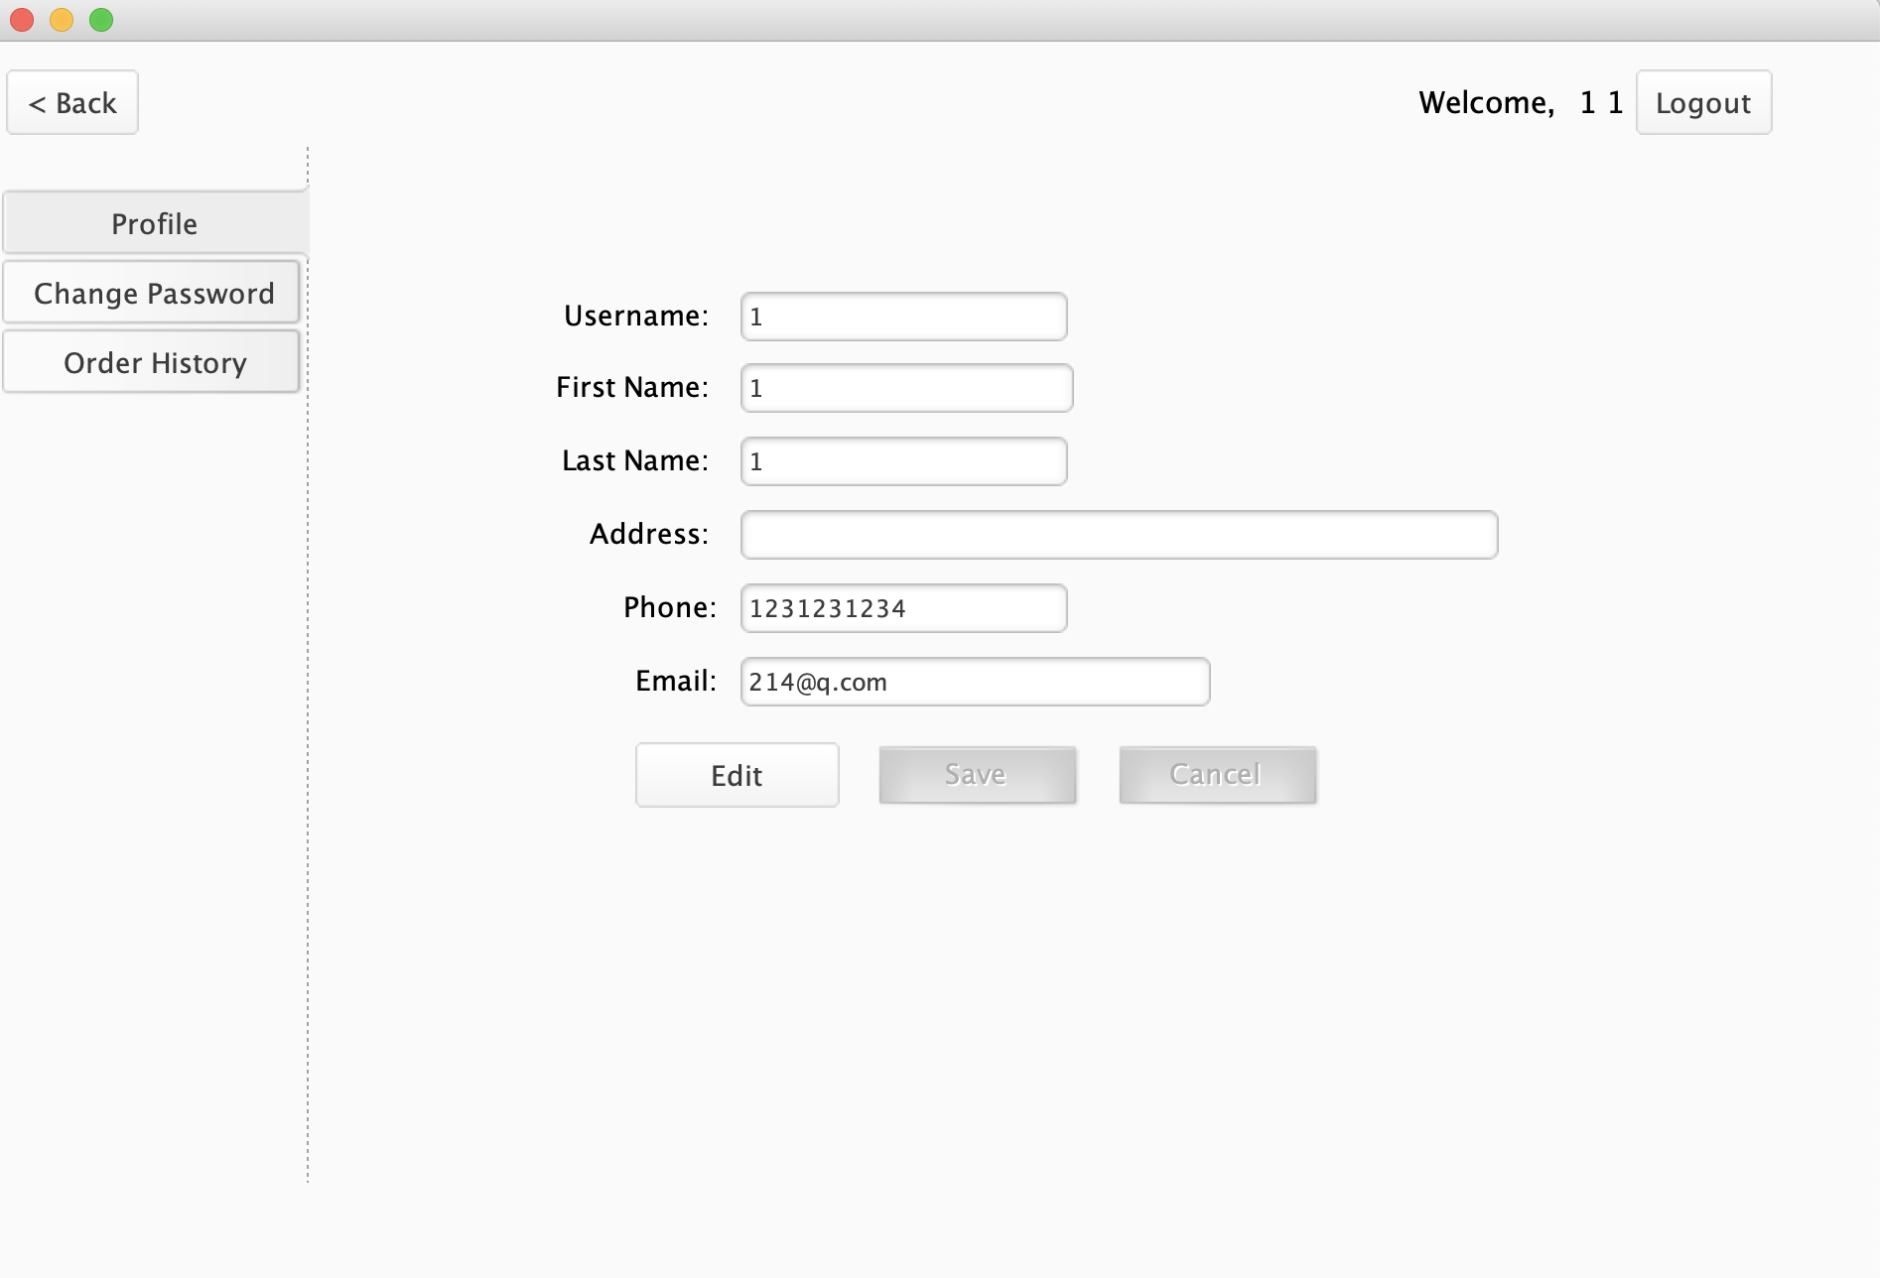
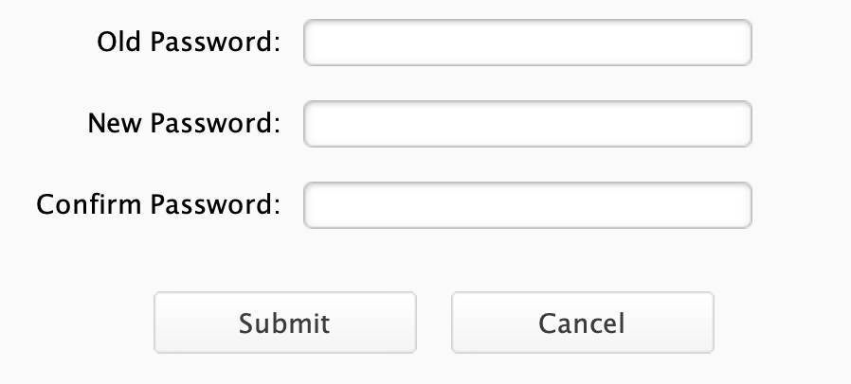
Customer Profile
For Customer

Slide 22
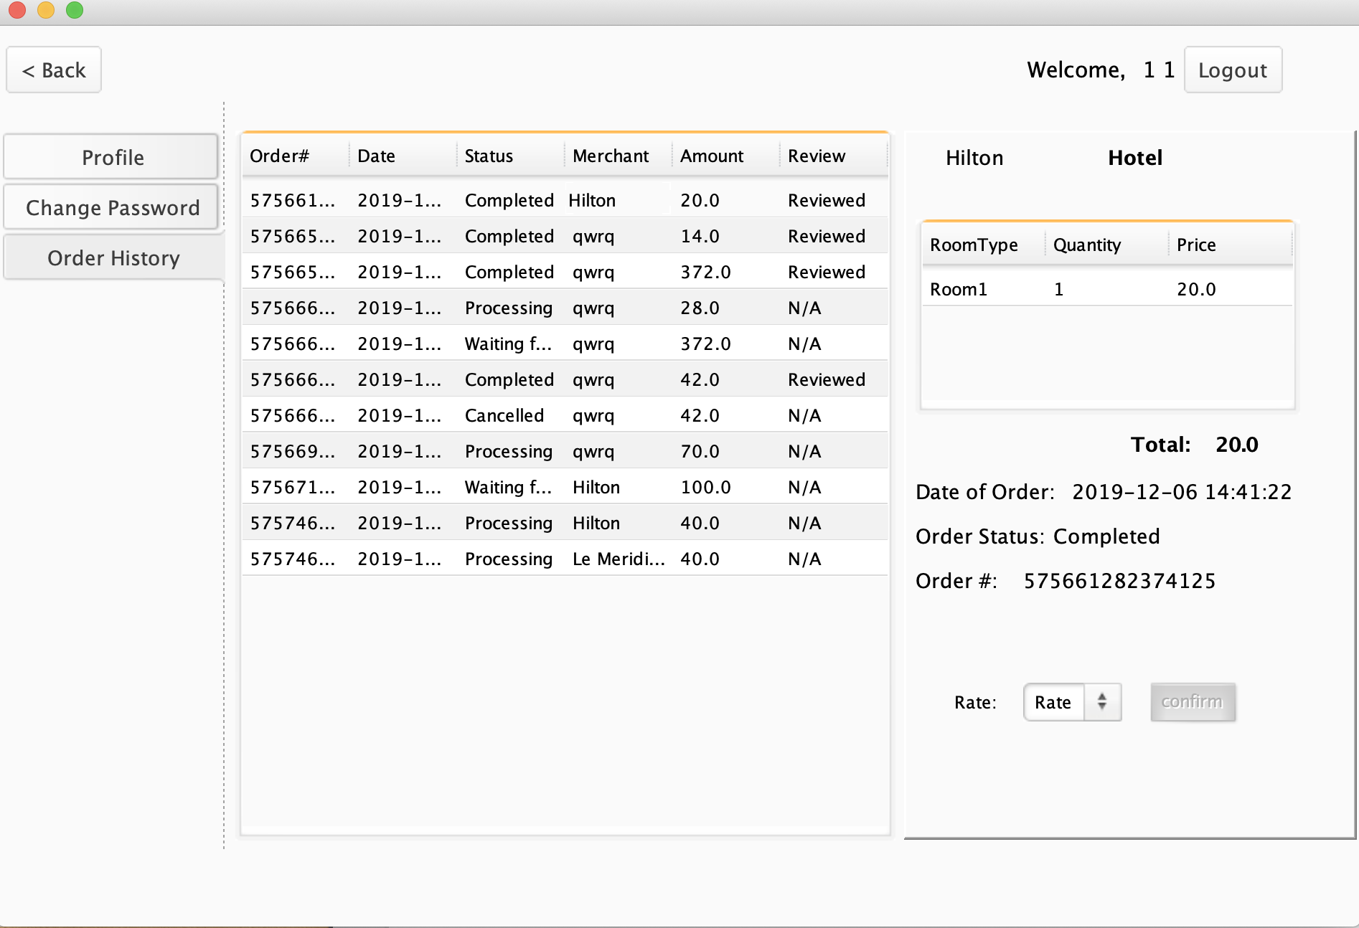
Order History
For Customer

Slide 23
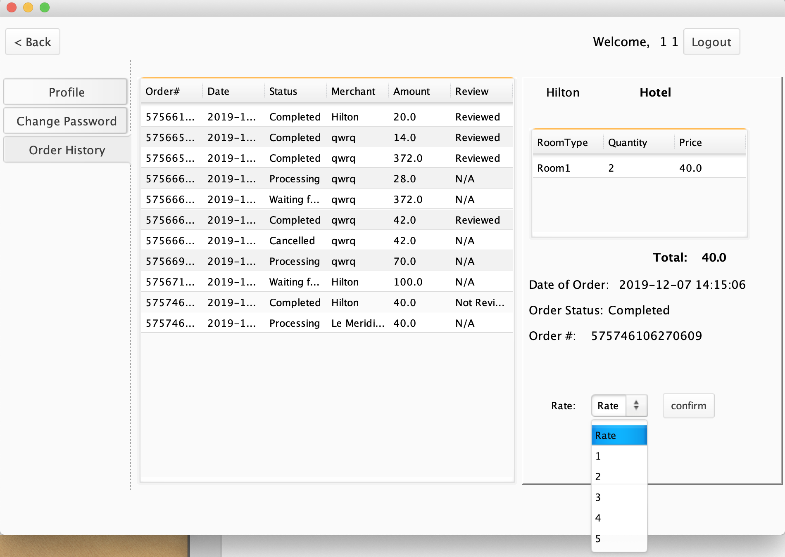
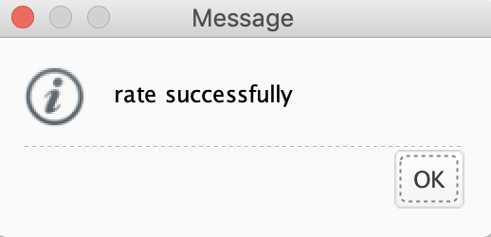
Review Order
For Customer

Slide 24
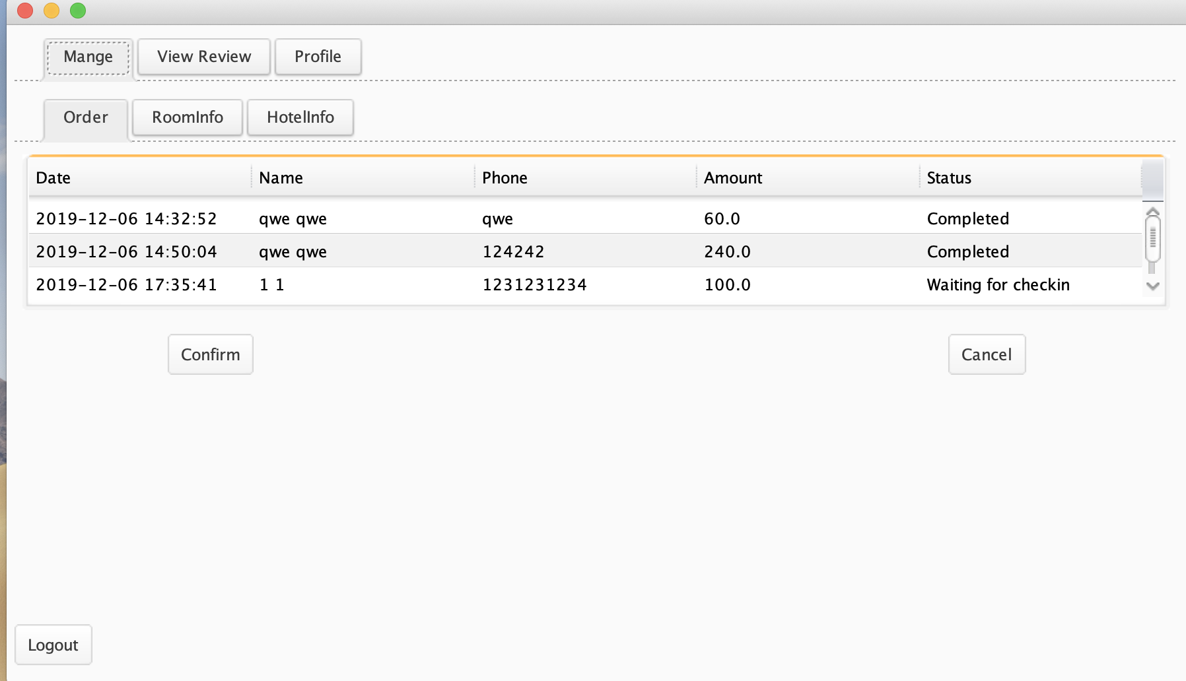
Check Status
For Hotel Manager

Slide 25
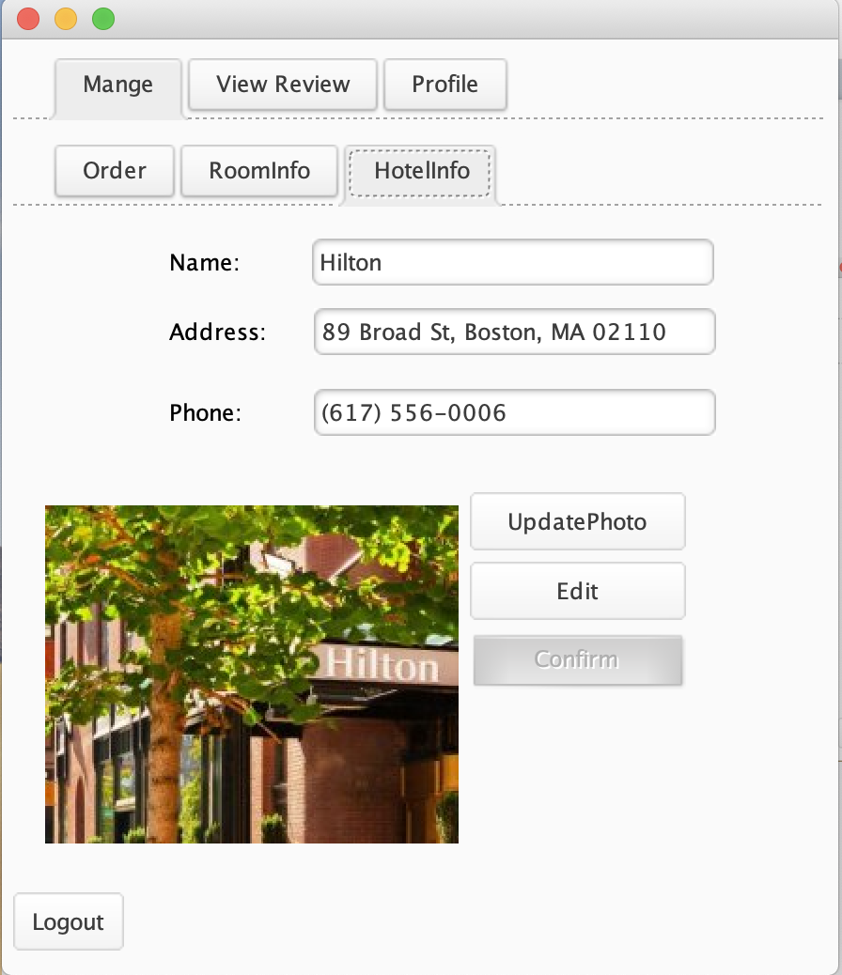
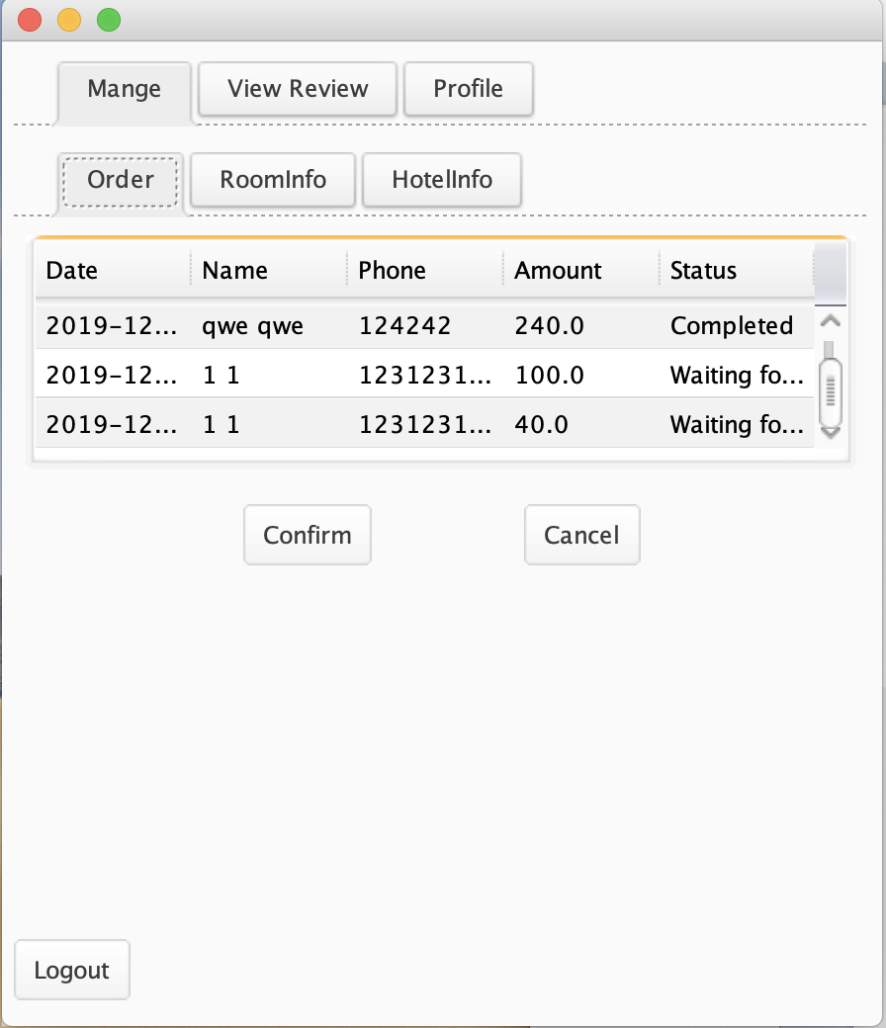
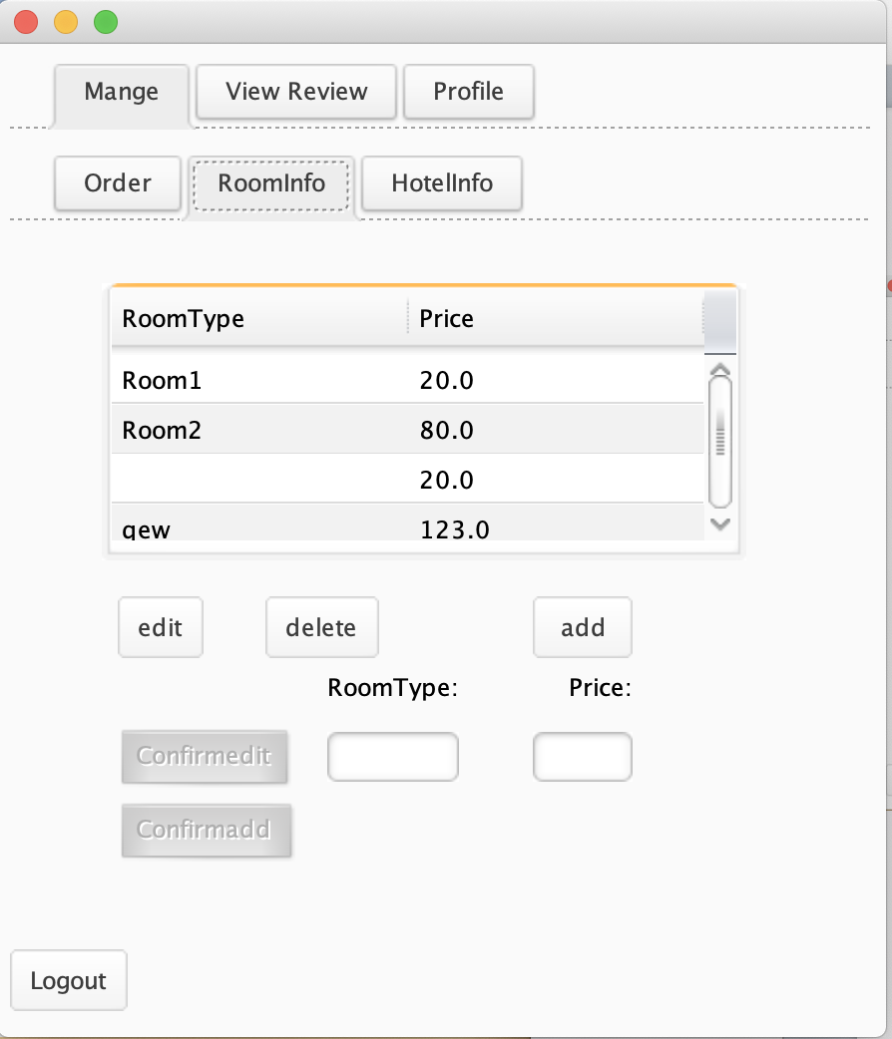
Manage Hotel
For Hotel Manager

Slide 26
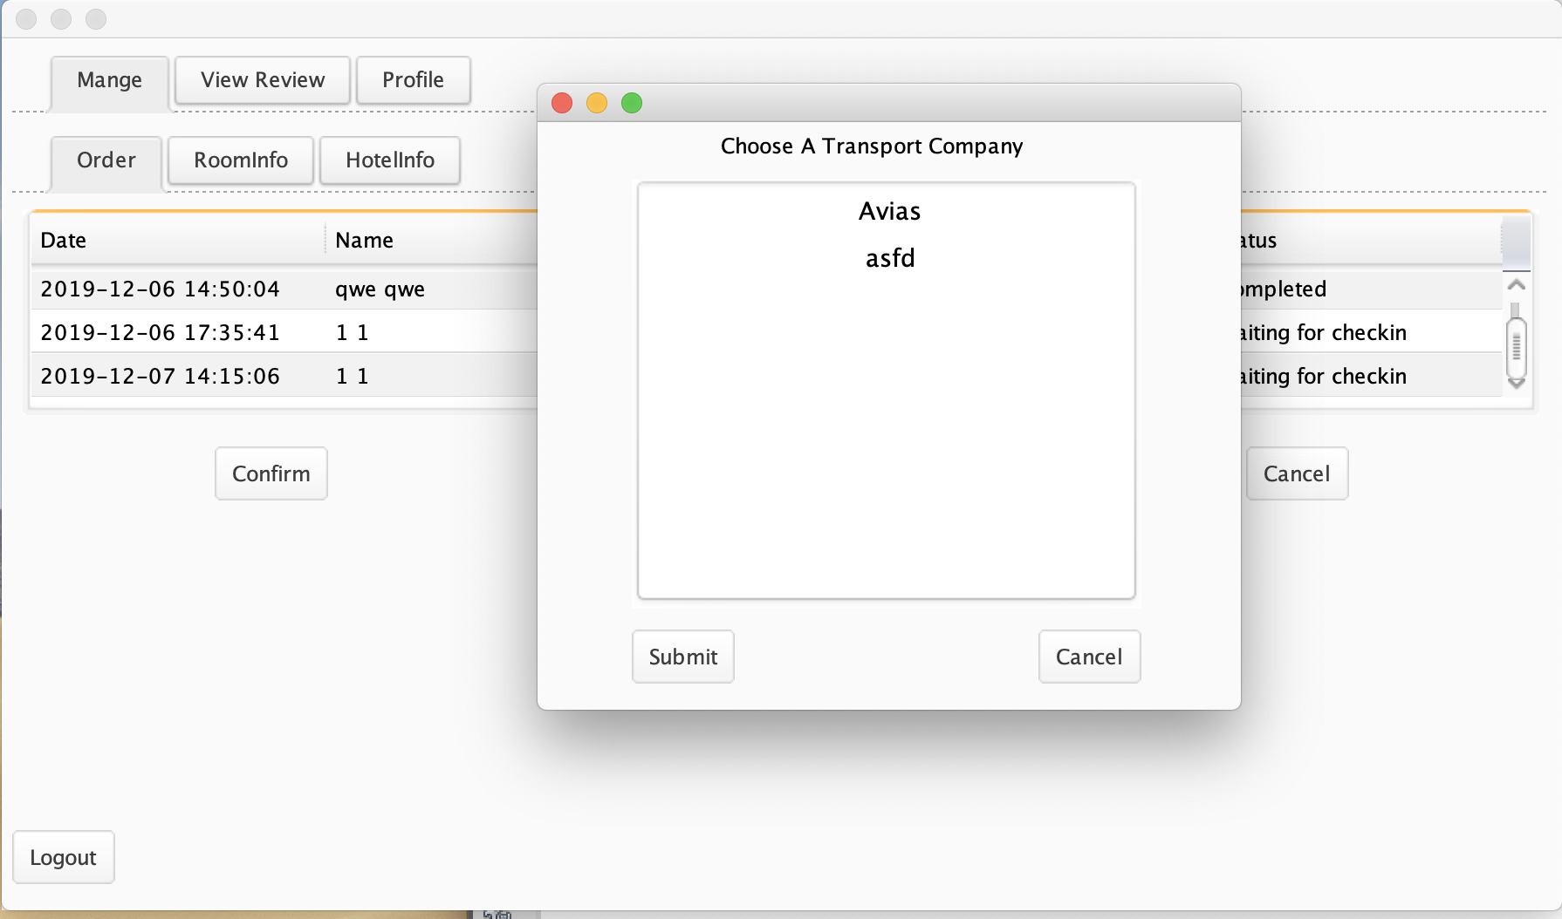
Check Status
For Hotel Manager
&Select TC

Slide 27
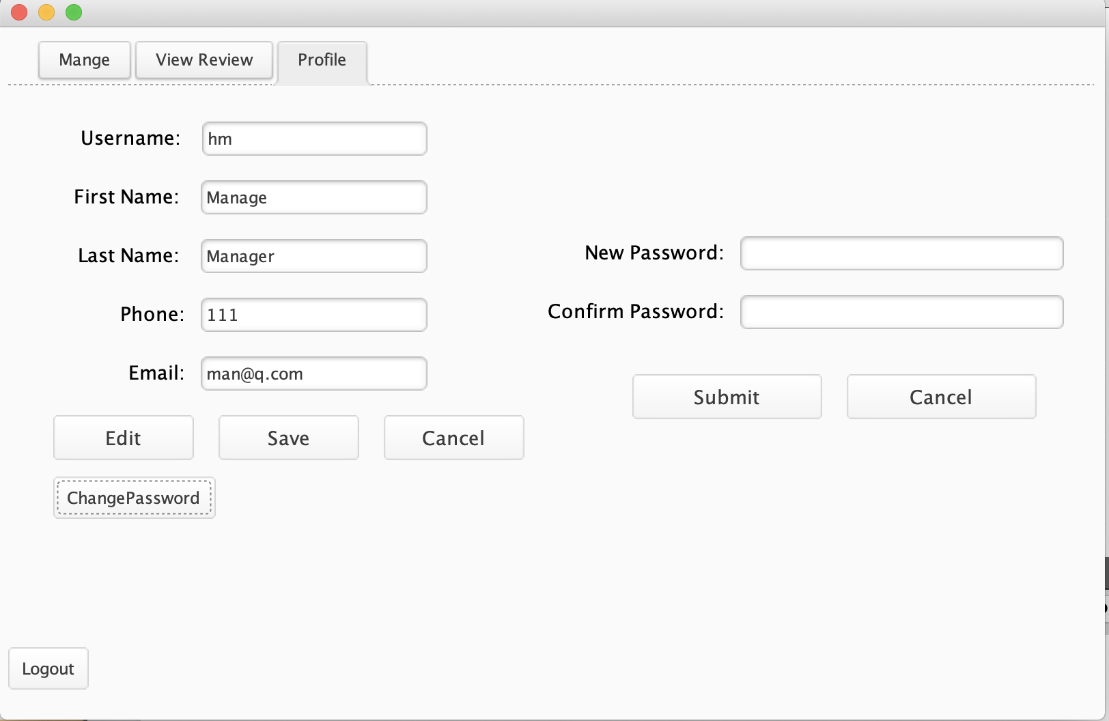
Edit Profile
For Hotel Manager

Slide 28
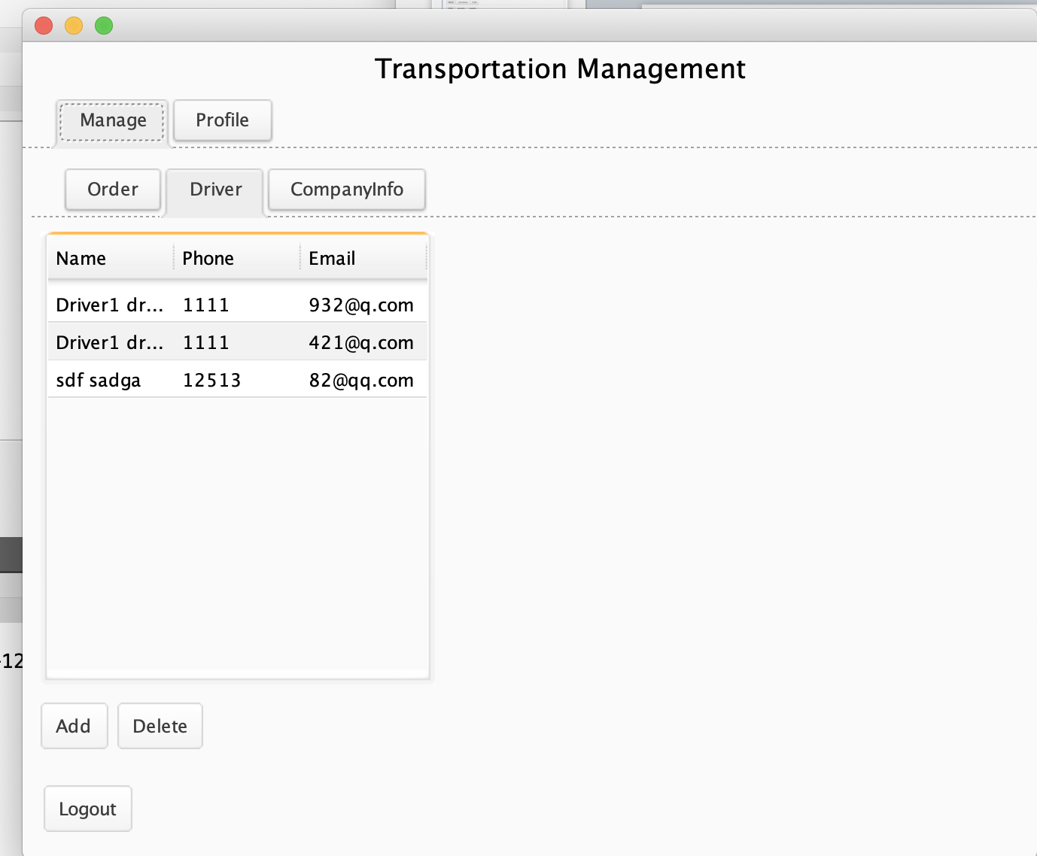
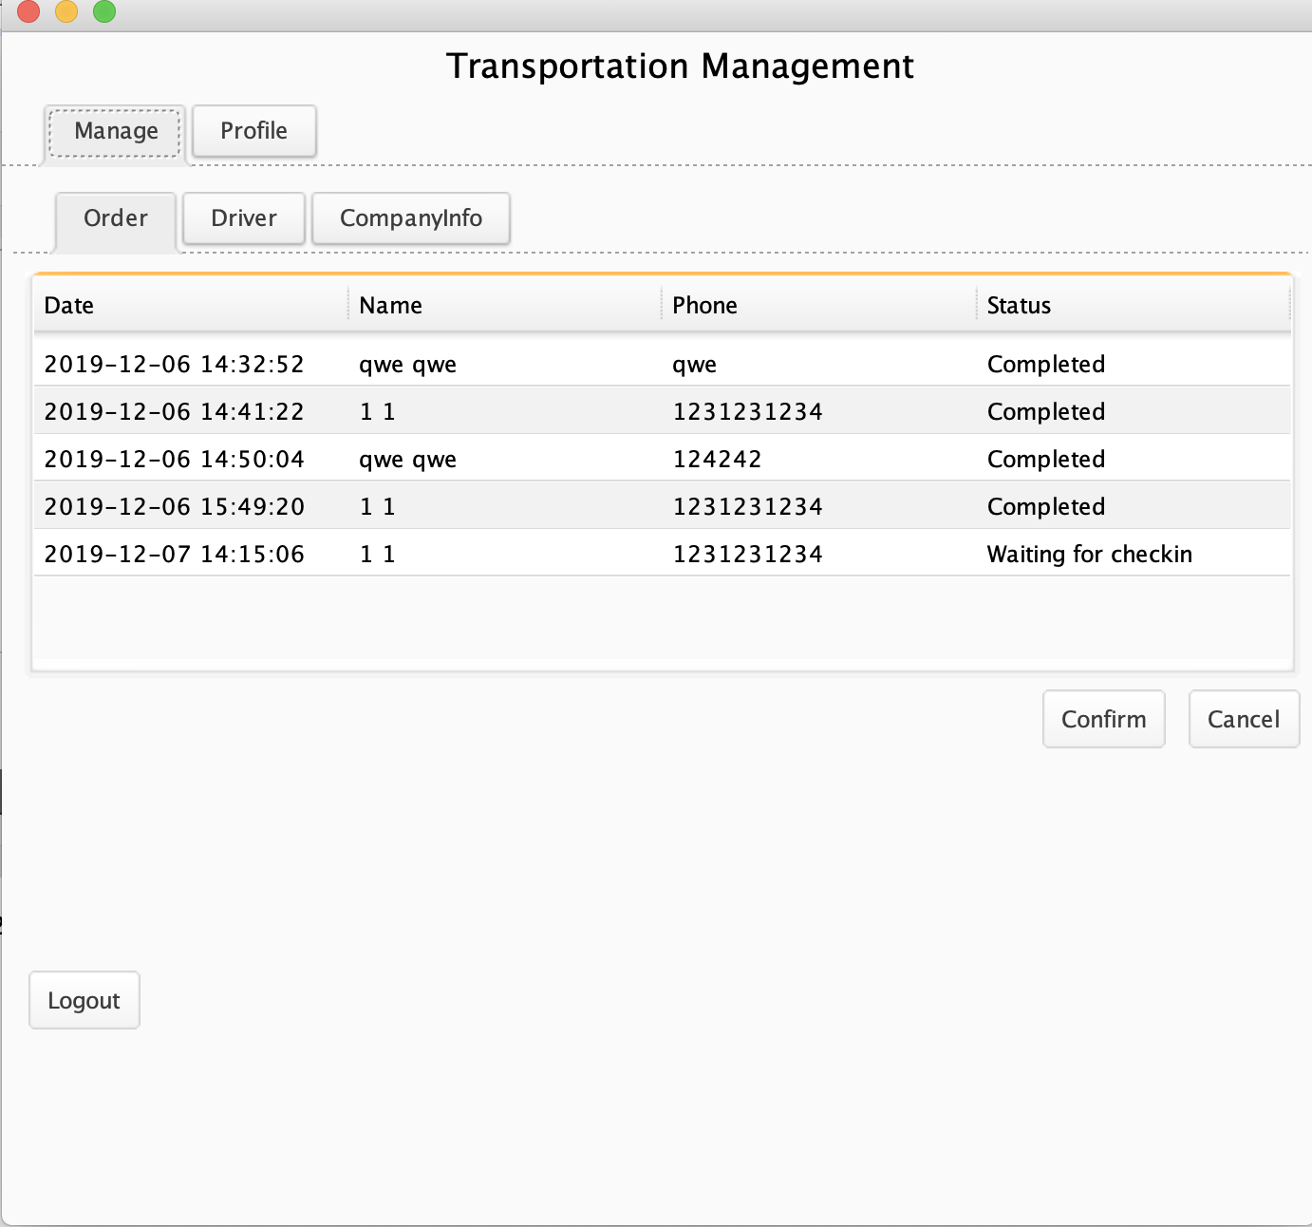
Manage Order&Driver
For transportation manager

Slide 29
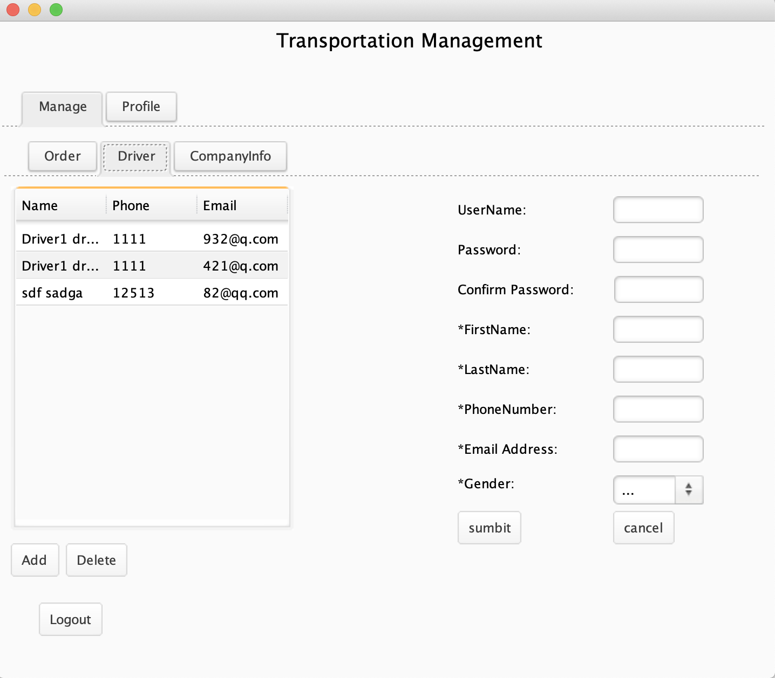
Add/Delete Driver
For transportation manager

Slide 30
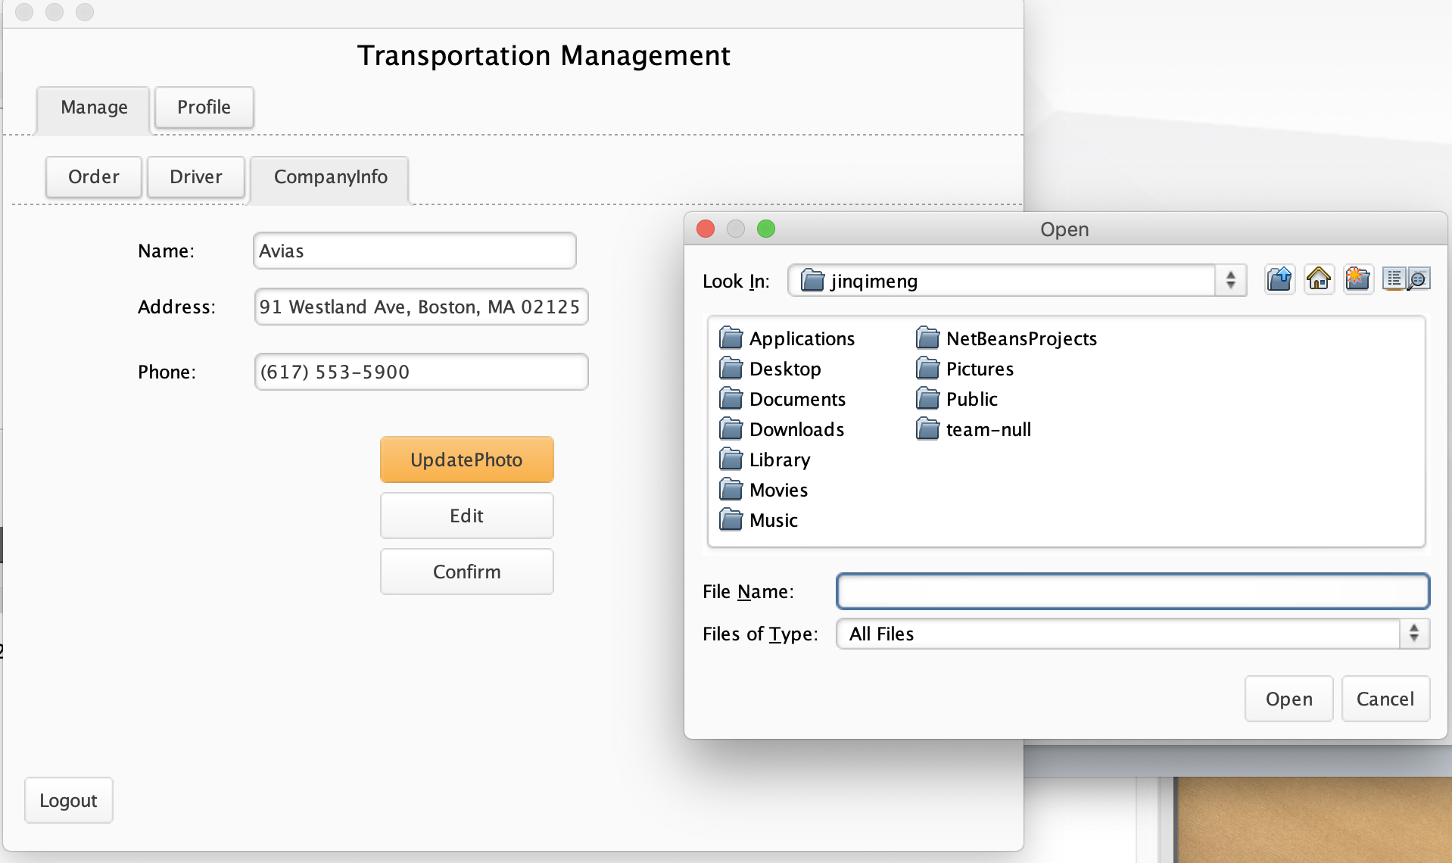
Edit Company Info
For transportation manager

Slide 31
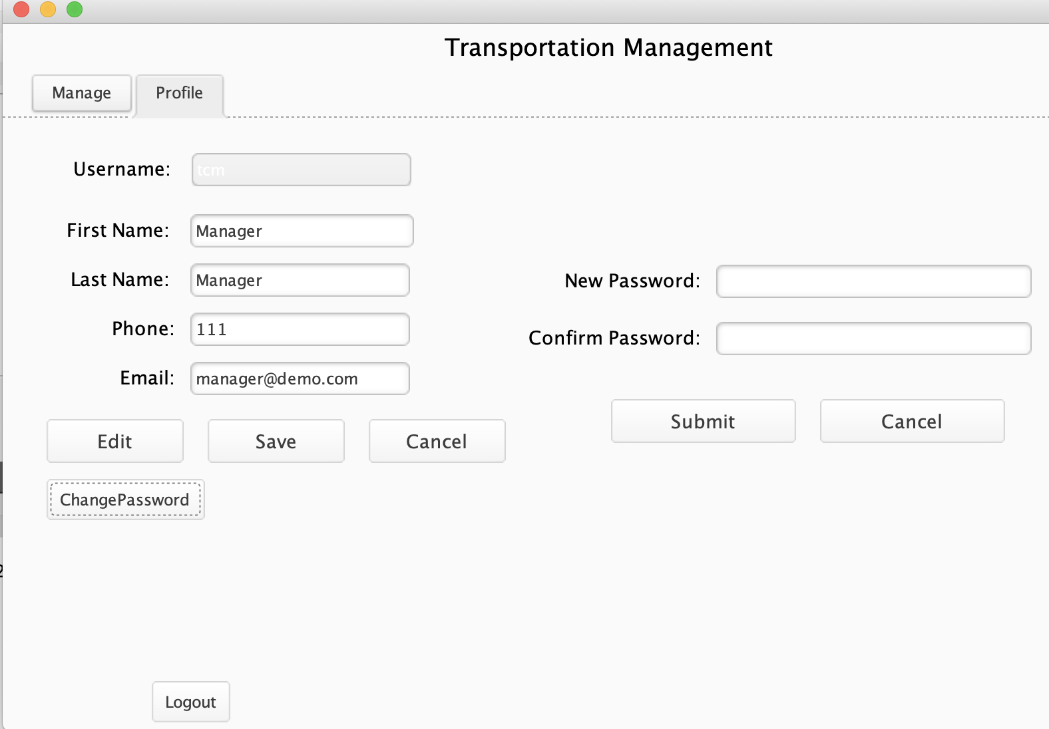
Edit Manager Info
For transportation manager

Slide 32
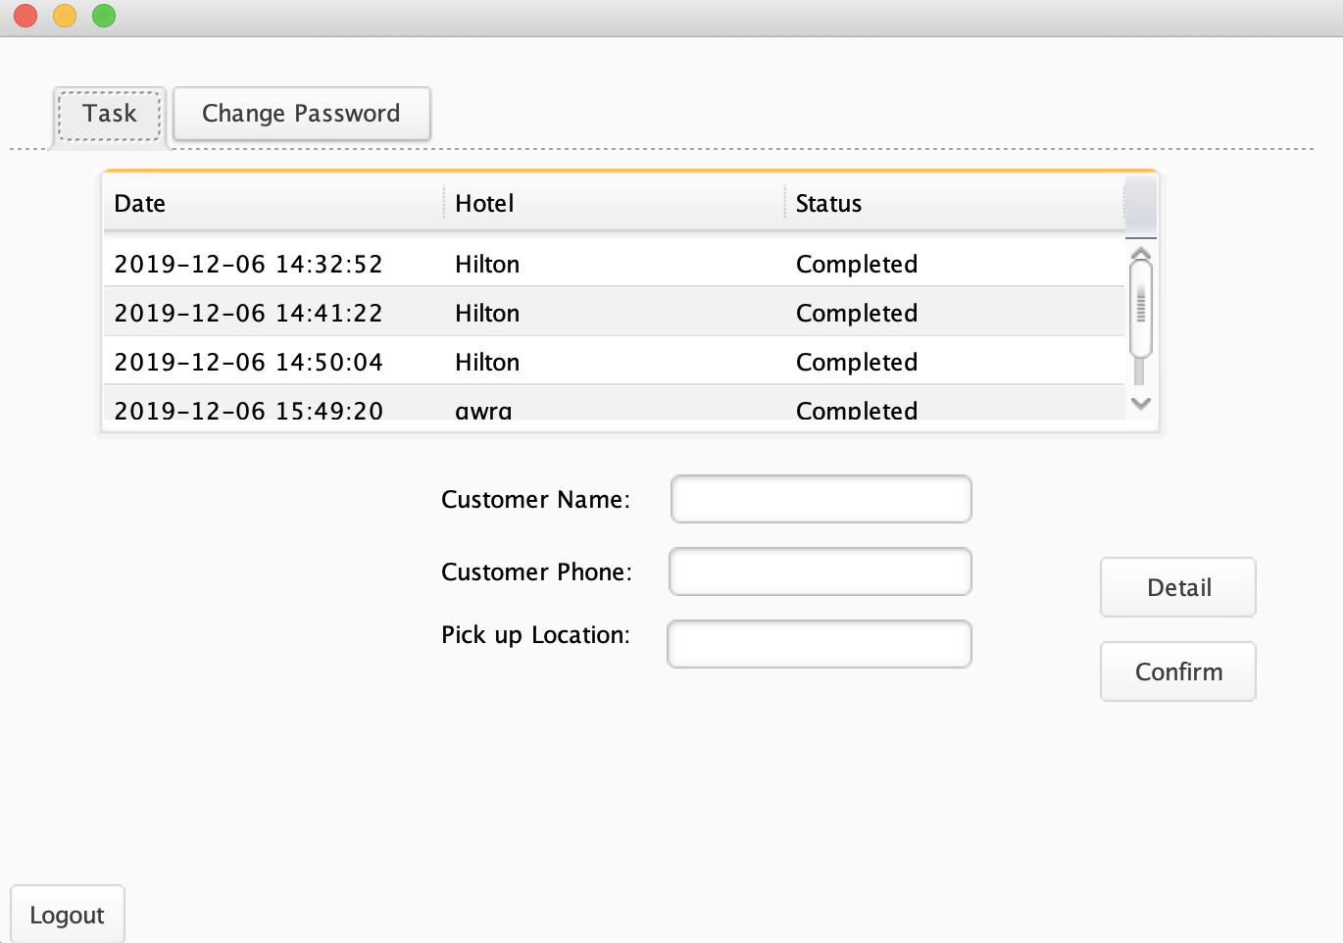
Check Task
For Drivers

Slide 33
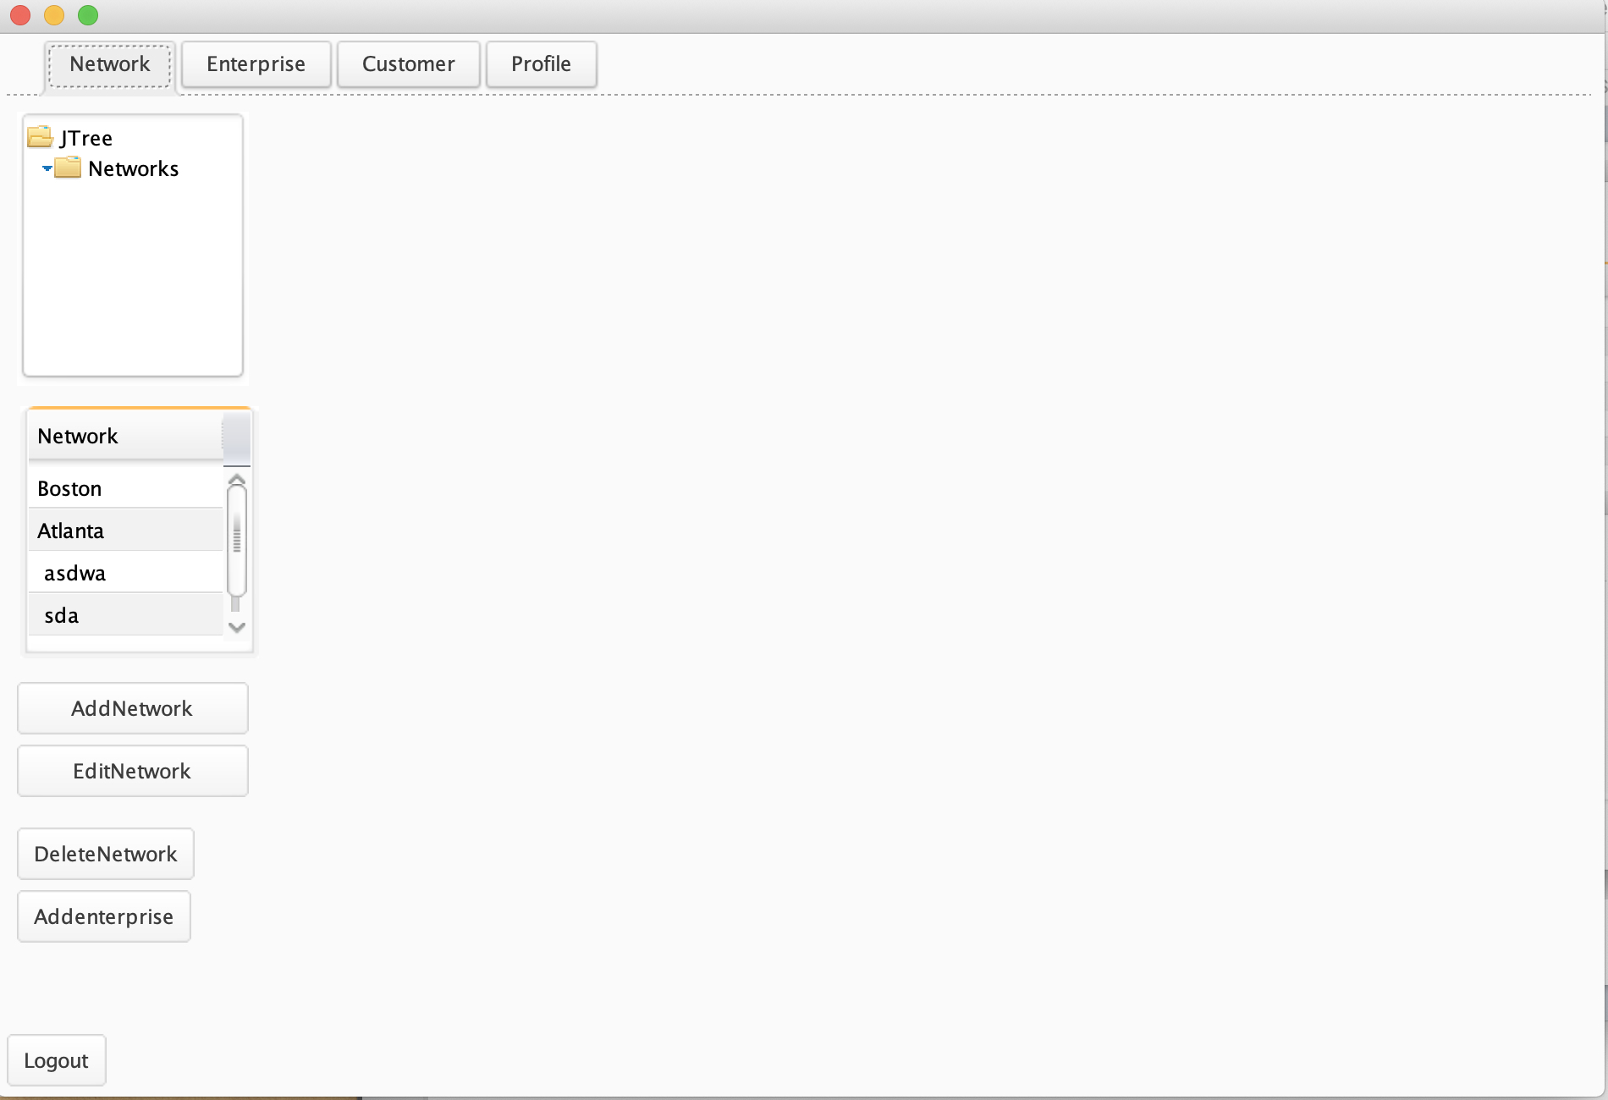
System Admin

Slide 34
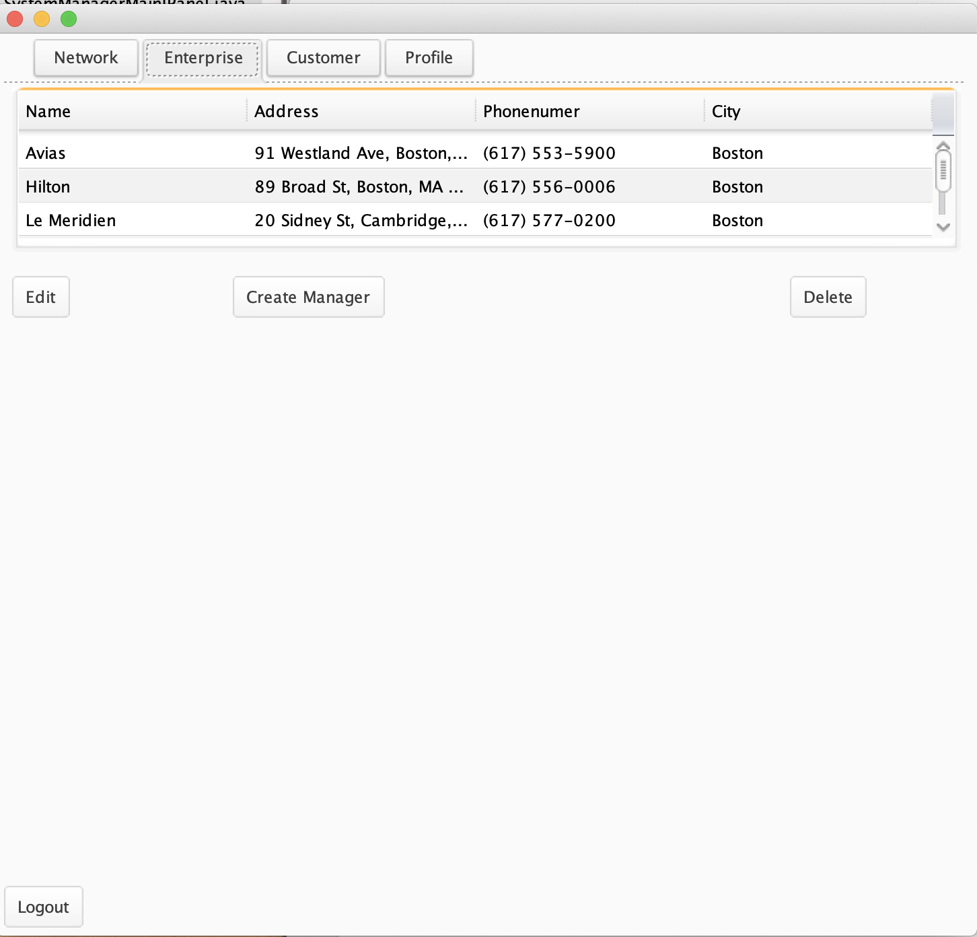
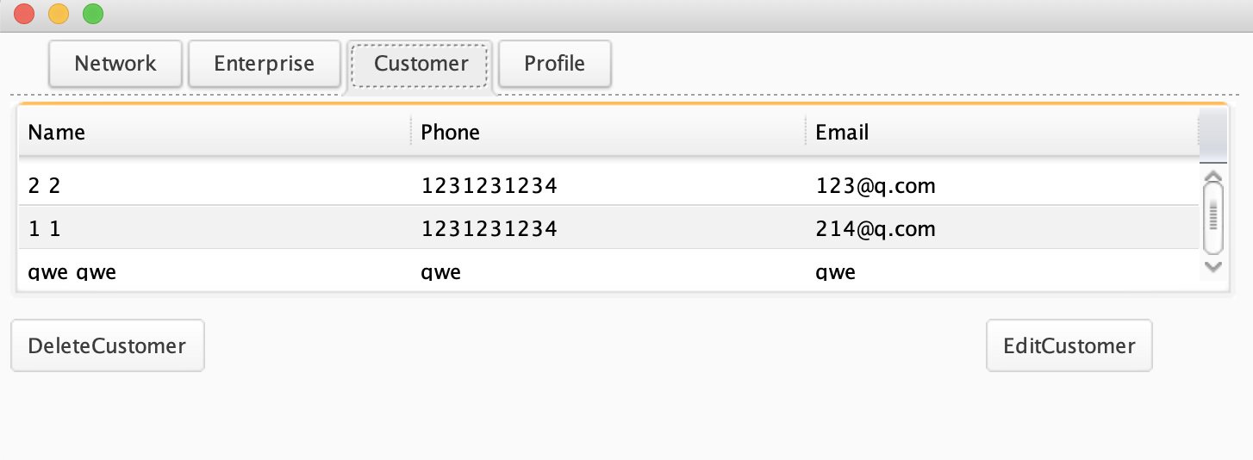
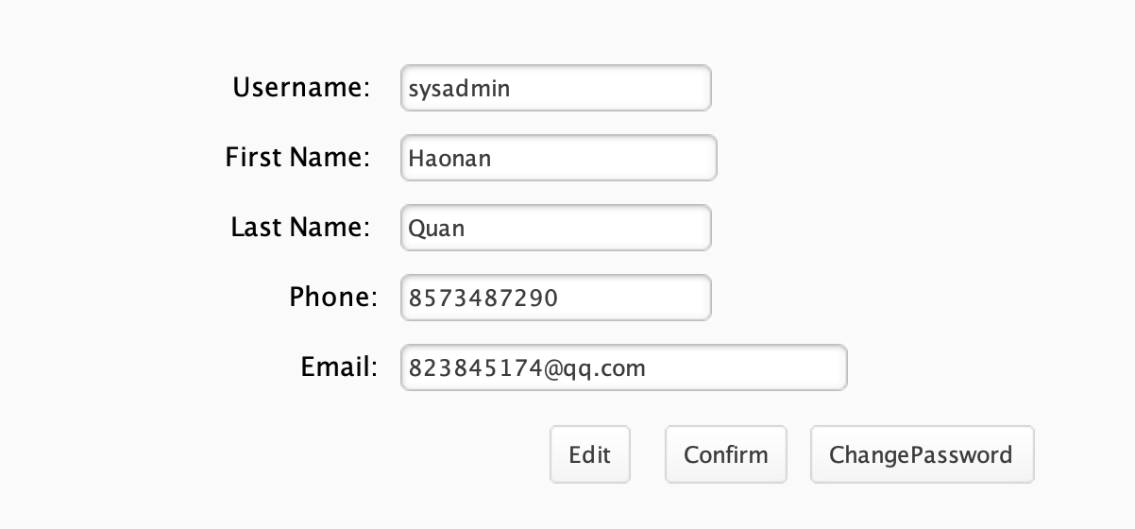
System Admin

Slide 35
THANKS
Team
NULL

